Slide 1


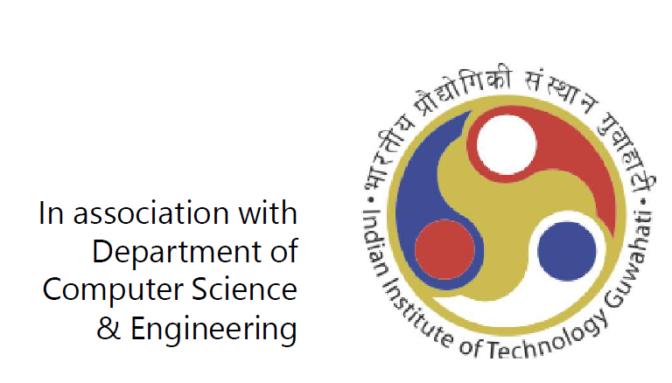

Slide 2
Agenda
Code.fun.do Program introduction – 30min
Technical Session – Pre-Dinner – 90min
Windows Universal App Development
Android App Development
Windows Azure Services
Dinner Break – 60min
Technical Session – Post-Dinner – 120min
Microsoft Cognitive Services
Bot Framework and Azure ML

Slide 3
Code.fun.do Snapshot
FY12 – 5 campuses, 5 events, 500+ students, 140+ Apps
FY13 – 10 campuses, 10 events, 1200+ students, 250+ Apps
FY14 – 15 campuses, 15 events, 1300+ students, 380+ Apps
FY15 – 15 campuses, 15 events, 1500+ students, 400+ Apps
FY16 – 15 campuses, 15 events, 1500+ students, 400+ Apps
Code.fun.do SHOWCASE – Winning team visiting Microsoft IDC to showcase their projects. All projects published on store with the support of Mentors.
Increased mindshare in top campuses across India
code.fun.do is now one of the most recognized hackathon/programming event across these campuses
More students adopting Microsoft Tools and Platforms

Slide 4
Code.fun.do - what’s new this year?
Mandatory early boot camp– be better prepared!
Hackathon moves online. Students get more time to build their hacks.
Winners of Online code.fun.do compete with Seniors in on-campus code.fun.do
Week long focused mentoring and interventions to increase your chances of submission!
Powerful set of themes - choose one and start building your app!
X platform development on our tools and services—learn more, achieve more with less efforts!
New technologies, new devices, new learnings!

Slide 5
Technology Platforms
Windows Universal App Development
Android App Development
Windows Azure Services
App Services, Web Apps, Storage
Microsoft Cognitive Services
Vision, Speech, Knowledge, Language, Search
Microsoft Bot Framework
Azure ML
Cross Platform App development
Use above technologies to build apps for Windows, Web, Android, iOS

Slide 6
Code.fun.do AI Challenge Themes
The Artist
Art is essential to human society, get creative and generate Art via AI. Help your AI generate paintings, jokes, poems and so on.
Now you see me
Help our bot start seeing things, which means that given an image input to the bot, what all can the bot see, and how it can respond.
The Social Network
We all spend so much time on social networks! In this challenge, we want to see how our bot can enhance the same. Since our AI is a chat bot, develop chat based experiences which inherently encourages social interaction. These experiences can be games or puzzles or anything else.

Slide 7
Code.fun.do Themes
Digital India
Hack for Good
Save Our Planet
Productivity
Entertainment
Notes:
Theme What it covers Digital India Use technology to help solve some of the major sectoral issues in agriculture, education, skilling, urban development, payment infrastructure etc. Hack for Good Technology is an enabler, a creator of innovative and scalable solutions that can mitigate social problems. Choose a social cause close to your heart--it could be anything from literacy, child rights, heathcare, accessibility, animal rights, etc--and show us how technology boost solutions for social good. Save our Planet There is general consensus among people and the scientific community that human beings are seriously damaging our planet to the point that all life on Earth is now threatened with extinction through the over-exploitation of the earth's resources, human caused climate change, destruction of habitats, and the pollution of the land, air and waters of our planet. If this bothers you, pick a topic and show us how technology can be used to solve problems around it. The topic could be anything---reduce carbon footprint, save our rivers, save our trees, global warming, etc Productivity We live in a world where technology is omnipresent in our lives. Whether you are a student, a home maker, a professional, a teacher, a large enterprise or an SMB---technology empowers you and enables you to do more--better, faster. If the power of technology to reinvent productivity excites you, pick this theme. Choose any persona of your choice and show us how you can use technology to improve their lives. Entertainment The world of entertainment has undergone an incredible change in the last decade. Seismic shifts in technology have allowed numerous disruptors to enter the market. Gone are the days when gaming would mean playing video games solo or a family entertainment outing would mean a visit to the local cinema hall. Our entertainment experiences now live along a time-line from their first planning to their happening to their broadcast, often simultaneously with the experience, and then well beyond as they’re shared and permanently archived, all made possible by technology. People today are seeing more value in doing things and sharing those experiences. Many people are perpetually connected via the Internet and smart phones. Experiences have now become a powerful vehicle for social expression, entertainment and conversation. If this world excites you, show us how you can use technology to make it even more exciting

Slide 8
code.fun.do Hackathon
Pre-Event
Event Registration followed by tech boot camp
Tech readiness and Tool training
Overview of all tech platforms for Bootcamp
Wonderful opportunity for non-CS and First year students to fast track learning
Code Samples, Online Courses will be distributed

Slide 9
code.fun.do Hackathon
Event Week
Participation
Registered students who have attended Bootcamp will get an invite to code.fun.do online portal
Team registration will be activated on the portal
Hackathon
One week long hack
Online support available from Microsoft mentors over email and online forum
Build app at your own pace from your own place
Submit the app (not the source code) and demo video online for judging

Slide 10
code.fun.do Hackathon
Post Event
Submissions
Teams to submit their app online along with a 3min demo video
Demo video should clearly highlight the functionality built in the app, along with known issues and bugs
The apps should be deployable on targeted device. Include a Readme in the upload archive.
Deadline – One Week from today.
Valid submissions will be judged by panel of Microsoft mentors
Results –
Top teams (3) would qualify for on-campus code.fun.do with Seniors.
T-shirt and Goodies to all successful submissions. Additional prizes for Top 3 teams.
Chance to compete with Seniors and Win big in on-campus code.fun.do

